Slide 1
Looking for a slam
In general the partnership needs 33 pts to play in a 6NT with balanced hands. Any 5 card suit reduces this to 32pts
For any slam you need to ensure that defenders cannot take 2 quick tricks

Slide 2
Asking for aces
There are 2 conventions to ask for aces
Gerber 4♣
Blackwood 4NT
Asking for aces is to keep the partnership out of unmakeable slams
For very advanced players you can use cue bids instead of asking for aces with some hands
In general do not ask for aces if you have an unsupported doubleton in an unbid suit

Slide 3
The Gerber convention
Use Gerber to ask for aces as a direct bid over partner’s opening bid of 1NT, 2NT
Instead use Blackwood to ask for aces over any suit bid; or any suit response to a no trump opening
After a suit bid you may need 4♣ to bid a natural suit, to make a cue bid or splinter bid (the last two for advanced players)
Responses to 4♣ Gerber: 4♦= 0 aces; 4 ♥= 1 ace; 4♠ = 2 aces; 4NT = 3 aces You should very rarely ask for aces if you do not hold any aces

Slide 4
Gerber over partner’s opening bid of 1NT/ 2NT
♠ A 9 3
♥ A K 7
♦ K Q 3
♣ K Q 5 4 2
♠ Q 9 3
♥ A 7 5
♦ K 5
♣ K J 3 2
♠ K 8 5
♥ Q J 7 5
♦ 6 3
♣ A K 8 4
1. Opener bids 1NT
You have 21 pts
And a 5 card suit so check up on aces, bid 6NT with 2 aces or 1 ace and 1 king in opener’s hand
2. Opener bids 2NT. You have 13 pts so bid Gerber to check that you do have 2 aces missing
3 Opener bids 2NT
You would not bid Gerber, try Stayman to see if you have a ♥ fit, and then bid Blackwood

Slide 5
The disadvantage of using Gerber is that you cannot use it for natural bids
♠ K Q J 9 32
♥ A
♦
♣ J 10 8 74 2
♠
♥ A K 7 6 5 4
♦ K 5
♣ K 10 9 7 5 3
These two hands are fine for a 4♣ rebid after you open 1 of the major and partner responds 1NT ( 4♣ = NOT Gerber).

Slide 6
The Blackwood 4 NT Convention
After any suit bid: 4NT asks for aces
Responses to 4NT: 5♣ = 0 or 4 aces; 5♦ = 1 ace; 5♥ = 2 aces 5♠ = 3 aces
Advanced versions of Blackwood for experienced players ONLY
Key card Blackwood uses 5 key cards: 4 aces and the king of agreed trumps. The responses are as above
Roman Key card Blackwood for the very experienced players
5 ♣= 0 or 3 key cards; 5 ♦= 1 or 4; 5♥ = 2 and missing the Q of trumps
5♠ = 2 key cards + the Q of trumps

Slide 7
When should you NOT use 4NT Backwood
1.. When 4NT is quantitative over 1NT/2NT opening bids, asking opener has a maximum or minimum points for the opening no-trump bid
2 When the response can take you too high. This can happen if your main suit is a minor, especially ♣ s
3.When you have a void and be wary if you have a doubleton in an unbid suit, without a K
Agree with partner whether to use Gerber over a 1NT /2NT or 3NT rebid
You would only want to do this when you first response is a 4 card suit

Slide 8
Another example
N the dealer
South hand
♠ J 8 7 6
♥ 7
♦ A Q 3 2
♣ K J 5 4
♠ A K Q 9 53
♥ A J
♦ K 5
♣ Q 8 6
N deals and passes and with no opposition bidding, the bidding goes
S bids 1♠ and N responds 3♠ ; S then bids 4NT, and finds only 1 ace in N hand., and hoping its the ace of ♣ in bids 6♠

Slide 9
Another example
N the dealer
South hand
♠ J 8 7
♥ A Q
♦ A Q 8 3 2
♣ K J 5 4
♠ A K 10
♥ K 10 7 5
♦ K 5
♣ A 8 6 4
N deals and opens 1♦and with no opposition bidding, S bids 1♥ and N responds 1NT (15-17) ; S then bids 4♣ (Gerber) and N shows 2 aces ( bids 4♠) and S bids 6NT . Agree this with partner

Slide 10
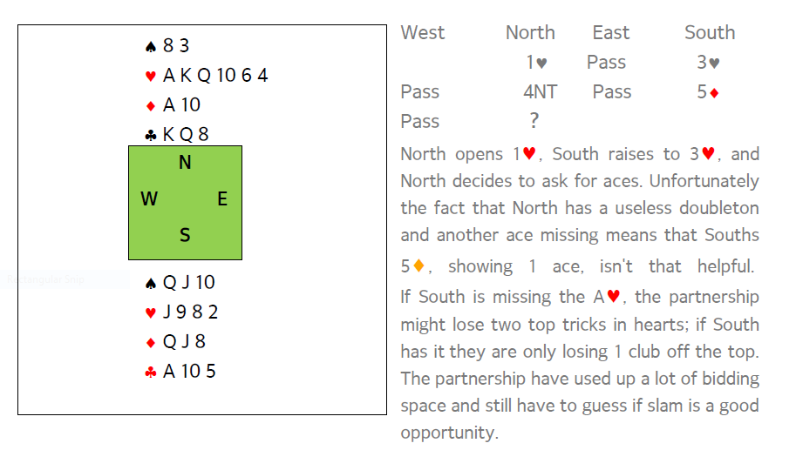

Slide 11
Asking for Kings only ask for the number of kings if the partnership holds all 4 aces
Gerber uses 5♣ to ask for kings: using equivalent responses to the 4♣ asking bid
Blackwood uses 5NT to ask for kings: using equivalent responses to the 4NT asking bid
If you use any form of key card Blackwood, you discount the king of the agreed trump suit in responding to 5NT

Slide 12
Cue bids as an alternative to asking for aces
For very experienced club players only, cue bids can be used to find a slam
If you have agreed a trump suit, and the partnership is already committed to GAME,
Then the bid of a a new suit is a “control showing” cue bid, either and ace or void. If the responder has 0 aces then sign off in the game
♠ A
♥ A K 7 6 5
♦ K 8
♣ K Q 5 4 2
You open 1♥ and partner responds 3♥ , showing the equivalent of 10-11 pts. You could just ask for aces using Blackwood, but you could be too high if you play in 5♥. Instead cue bid 3♠ and if partner cue bids any of the minor suit aces bid 6♥, otherwise sign off in 4♥.
dealer

